Slide 1
YouTube Data Harvesting and Warehousing

Slide 2
Project Overview
→ Data harvesting from YouTube API
→ Data storage in MySQL database
→ Data analysis and visualization using Streamlit

Slide 3
Technologies Used
Python
YouTube Data API
MySQL
Streamlit
pandas

Slide 4
Flow Of Execution:
User inputs YouTube Channel ID
Retrieve channel and video data from YouTube API
Store data in MySQL database
Execute predefined queries on stored data
Display results in Streamlit interface

Slide 5
User Defined Functions:
get_channel_data(): Retrieves channel information
get_video_data(): Fetches individual video details
insert_data_to_mysql(): Stores data in MySQL
get_predefined_query(): Executes SQL queries

Slide 6
Database Schema
Database Name: youtube_data
Table Name : Channels
Table Name : Videos

Slide 7
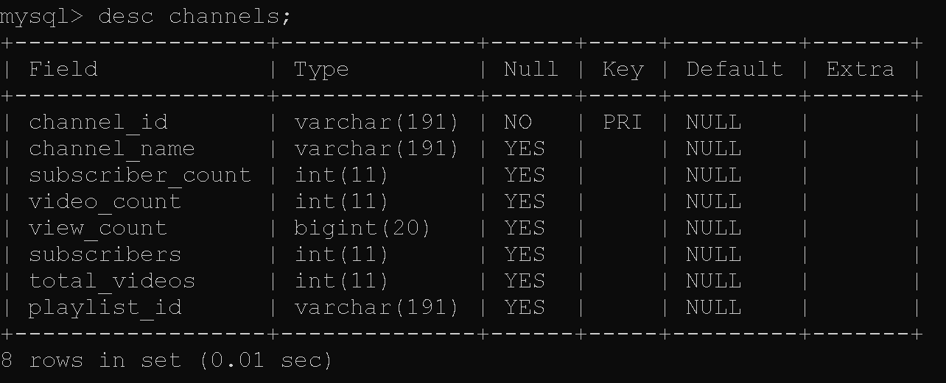

Slide 8
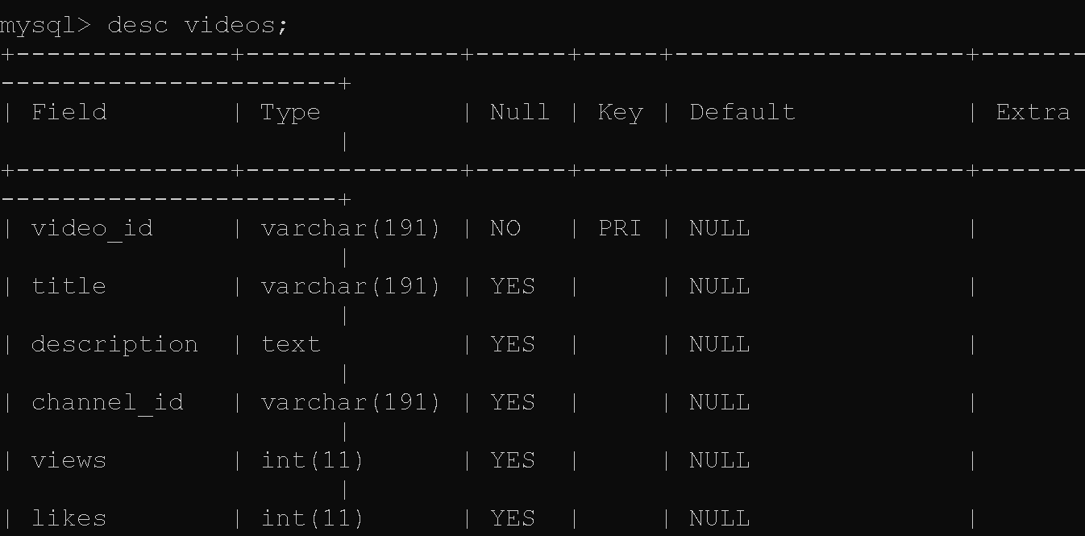
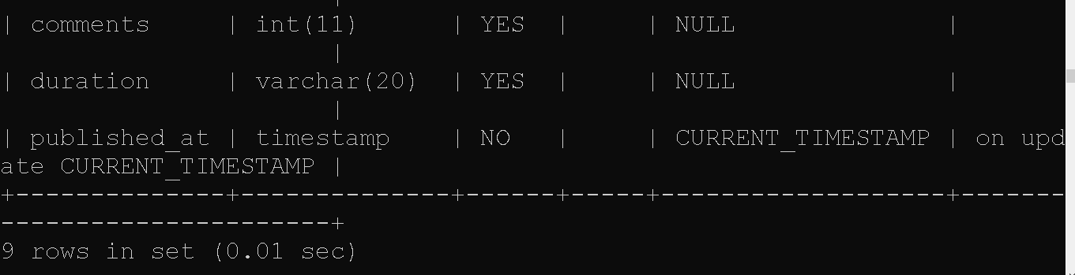

Slide 9
Streamlit User Interface:
Input field for YouTube Channel ID
Button to data retrieval and storage
Dropdown menu for selecting predefined queries
Display area for query results

Slide 10
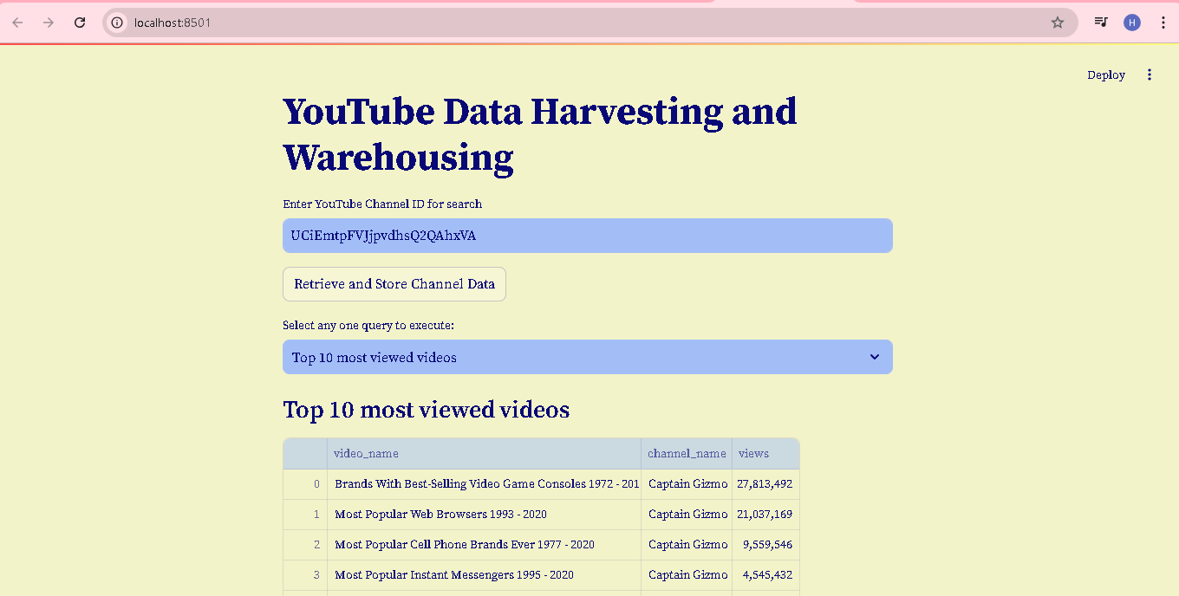
FRONT END

Slide 11
Sample Queries
Video names and their channels
Channels with most videos
Top 10 most viewed videos
Comments count for each video
Videos with highest likes
Total likes for each video
Total views for each channel
Channels with videos published in 2022
Average video duration for each channel
Videos with highest comment count

Slide 12
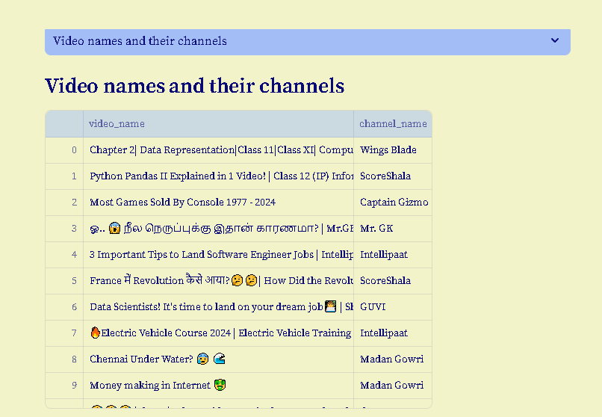
Queries Output

Slide 13
→ Efficient YouTube data harvesting and warehousing solution. → Valuable tool for content creators and marketers.
Conclusion

Slide 14
Q&A
Thank you for your attention! Any questions?

Slide 15
Thank You

